Slide 1
Analysis and prediction of California housing prices

Slide 2

Introduction
California housing prices have experienced significant changes over time, exhibiting both periods of rapid growth and periods of decline.
In this project, we will predict California housing prices with predictive machine learning models and the Root Mean Square Error based on features such as the median house value, median income, housing median age, population and total rooms.

Slide 3
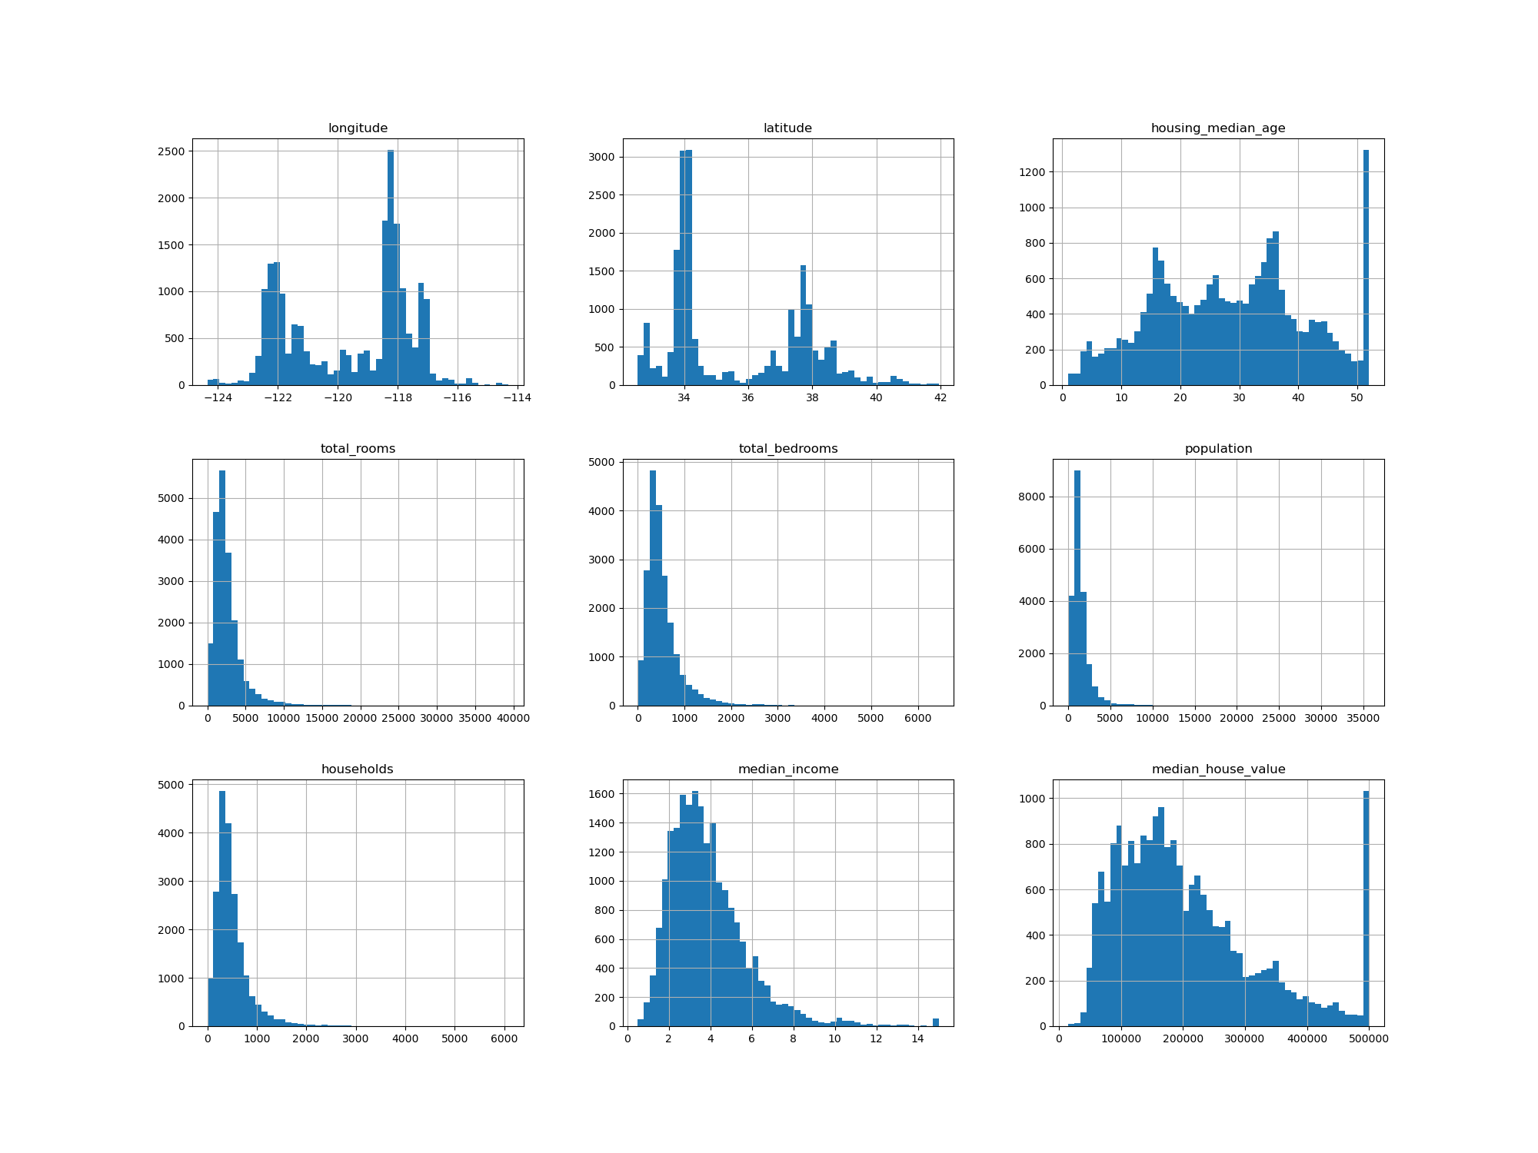
Data Exploration
The dataset was imported from Kaggle with 20639 observations, 10 attributes columns consisting of longitude, latitude, housingMedianAge, totalRooms, totalBedrooms, population, households, medianIncome , medianHouseValue, oceanProximity.
Distributions of the variables

Slide 4
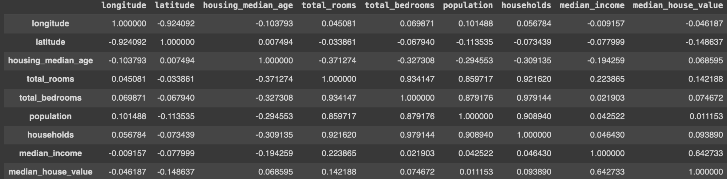
Looking for correlations
Compute the standard correlation
coefficient (also called Pearson’s r)between every pair of attributes using the corr() method

Slide 5
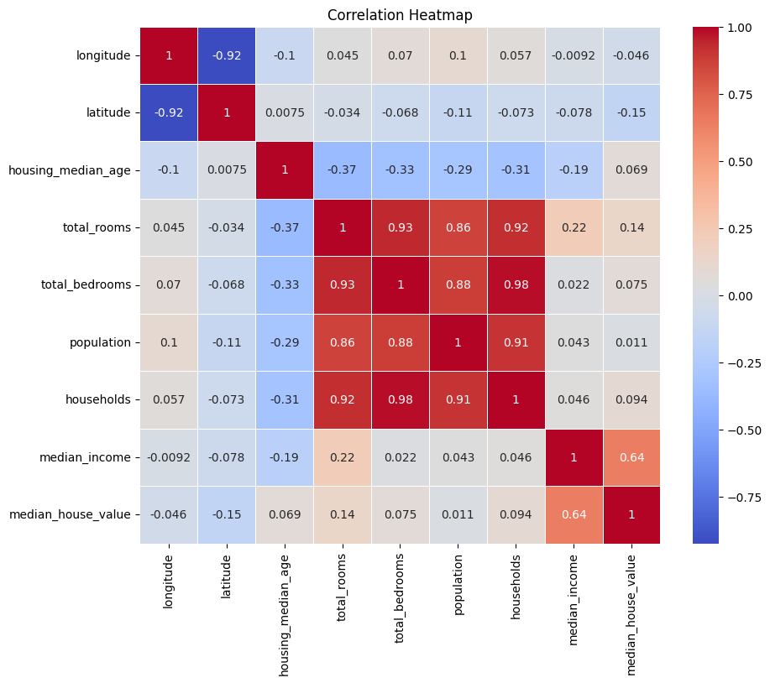
Looking for correlations (2)
The correlation coefficient between population and house value is 0.011.
The correlation coefficient between income and house value is 0.64. This correlation makes intuitive sense as areas with higher-income residents are likely to have more expensive houses.
The correlation coefficient between house value and total rooms is 0.14. This suggests that districts with more rooms tend to have slightly higher house value, as big houses have more rooms. This correlation confirmed with income and total rooms.
Interesting correlation coefficient, between population and housing age, which is negatively correlated, -0.29. As population increases we tend to build new housing.

Slide 6
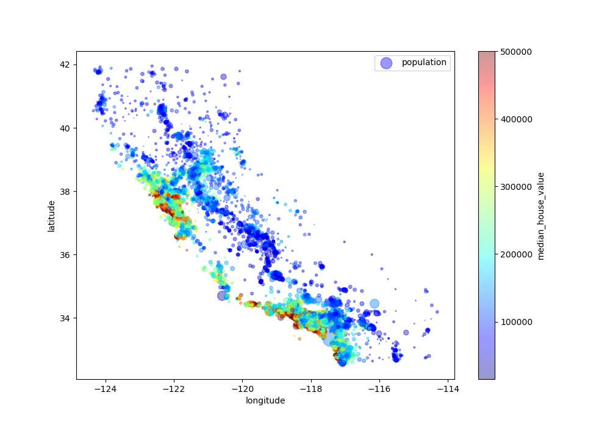
Geographical Representation
Housing data is better appreciated with a spatial distribution.
Here we are plotting the house coordinates. Also, we are attributing the color to the median house value and the size to the population.
We clearly see that the population and the houses’ values increase near the coast.

Slide 7
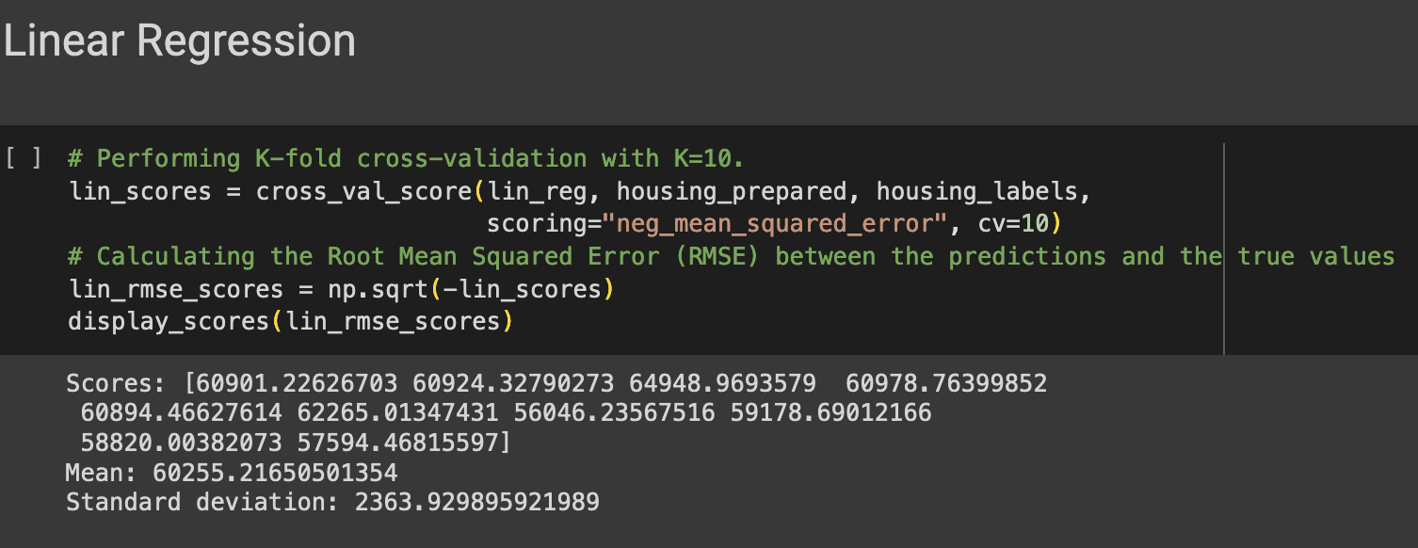
Linear Regression
Start by using Linear Regression to fit our response variable house_labels (e.g. median house value) on the predicted data houseing_repared
To evaluate the model we use K-Fold Cross-Validation. This is a robust method for estimating the performance of a model on unseen data.
Linear Regression makes multiple assumptions in the data such as linearity, homoskedasticity, independence…

Slide 8
Flexible non‐linear models

Slide 9
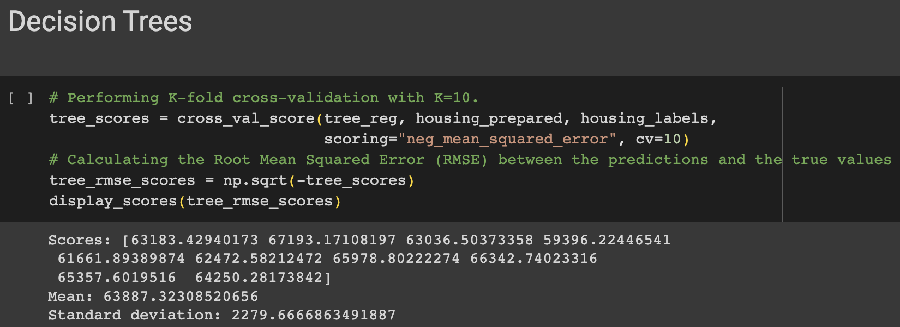
Decision Trees
1. Cross-validation with K=10: Randomly splitting the training set into 10 distinct subsets (or "folds") of equal size, then making predictions and evaluating them 10 times, each time using a different fold for evaluation and the remaining 9 folds for training.
2. Scoring method: Define the scoring metric to be negative mean squared error. The MSE is a measure of how close the model's predictions are to the actual values.
3. Calculation of RMSE: Multiply the resulting scores from the cross-validation by -1, then take the square root of these scores to calculate the RMSE, which is a more interpretable measure of the model's performance.

Slide 10
Flexible non‐linear models
What is boosting?
Sometimes referred to as an ‘ensemble method.’ Boosting is a method of converting a set of weak learners into strong learners. Sometimes you use performance enhancing methods like boosting and bagging that strongly improves out‐of‐sample performance.
Boosting fits smaller trees and instead learns slowly by sequentially adding small trees fit to the prediction errors of the existing ‘ensemble’ of trees.
The different types of boosting algorithms are:
AdaBoost
Gradient Boosting
XGBoost

Slide 11
Boosting
AdaBoost works on improving the areas where the base learner fails. The base learner is a machine learning algorithm which is a weak learner and upon which the boosting method is applied to turn it into a strong learner. Any machine learning algorithm that accept weights on training data can be used as a base learner.
Gradient Boosting. In this method we try to visualise the boosting problem as an optimisation problem, i.e we take up a loss function and try to optimise it.
Features of XGBoost are:
Clever Penalisation of Trees
A Proportional shrinking of leaf nodes
Newton Boosting
Extra Randomisation Parameter
In XGBoost the trees can have a varying number of terminal nodes and left weights of the trees that are calculated with less evidence is shrunk more heavily.

Slide 12
Boosting
AdaBoost works on improving the areas where the base learner fails. The base learner is a machine learning algorithm which is a weak learner and upon which the boosting method is applied to turn it into a strong learner. Any machine learning algorithm that accept weights on training data can be used as a base learner.
Three tuning parameters
The number of trees, B (or ). If very large can over‐fit
Shrinkage parameter, , determines the rate at which we are learning (adding
new trees). Small can mean large B is needed to fit data well
The number of splits in each tree, d – interaction depth. If d = 1 we are fitting
an additive model; each tree is just a single split (a stump!)

Slide 13
XGBOOST
Scores: [44482.9887755, 44798.21949354, 47032.90166137, 44928.59093062,
43429.67155493, 43063.08399882, 41734.46891318, 41248.7363088,
44528.32146324, 42594.4312484 ]
Mean: 43784.14143484058
Standard deviation: 1631.7221925305182

Slide 14
Random Forest Regression
Evaluating the performance of a random forest regression model using K-fold cross-validation and providing an estimate of the RMSE through the following steps:
Performing K-fold cross-validation into 10 folds and training a random forest regression model on each fold.
Calculating the negative mean squared error for each fold because cross_val_score expects scores where higher values are better.
Calculating the RMSE by taking the square root of the negative mean squared errors obtained from cross-validation..
Scores: [46352.36807333 , 47233.03957886, 46093.71196704, 45961.51587084, 44541.68062721, 46485.61292921, 42941.6557986, 44425.94434516, 44940.36667025, 44152.17723606]
Mean: 45312.8073
Standard deviation: 1251.5343

Slide 15
Conclusion
Based on the analysis, two significant correlations were observed. Firstly, there is a strong correlation between house values and proximity to the ocean, as depicted in the geographical visualization. Additionally, the correlation heatmap reveals a high correlation between house values and the median income.
Regarding the predictive models, the XGBoost regressor demonstrated the lowest RMSE among the four models, suggesting it may be the most accurate for predicting house prices in California. However, it's worth considering the standard deviation of the RMSE scores, which indicates the variability or uncertainty in the models' performance. In this regard, the Random Forest Regressor exhibited the most stable performance in predicting house prices in California.

